Slide 1
CIS 4517/5517: Data Intensive and Cloud Computing Data and Cloud Storage
Dr. Xubin He
Computer and Information Sciences
Temple University

Slide 2
Outline
Data storage fundamentals
Cloud Storage
Erasure-coded cloud storage

Slide 3
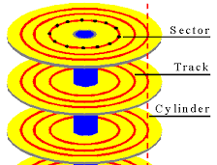
Big data: IO Bounded
Reading a word from disk versus main memory: 10⁵ slower!
Reading many contiguously stored words is faster per word, but fast modern disks still only reach 150MB/s for sequential reads.
IO Bound: biggest performance bottleneck is reading / writing to disk. (starts around 100 GBs; ~10 minutes just to read).

Slide 4
I/O Bus
CPU chip
Register file
ALU
System bus
Memory bus
Main
memory
Bus interface
I/O
bridge
I/O bus
Expansion slots for
other devices such
as network adapters.
USB
controller
Graphics
adapter
Disk
controller
Mouse
Keyboard
Monitor
Disk

Slide 5
Memory hierarchy
RAM
SRAM, DRAM
Storage
HDD
SSD
L0:
Registers
L1:
L1 cache
(SRAM)
L2:
L2 cache
(SRAM)
L3:
Main memory
(DRAM)
L4:
Local secondary storage
(local disks)
Remote secondary storage
(tapes, distributed file systems, Web servers)
L5:

Slide 6
Reading a Disk Sector (1)
CPU chip
CPU initiates a disk read by writing a command, logical block number, and destination memory address to a port (address) associated with disk controller.
Register file
ALU
Main
memory
Bus interface
I/O bus
USB
controller
Graphics
adapter
Disk
controller
mouse
keyboard
Monitor
Disk

Slide 7
Reading a Disk Sector (2)
CPU chip
Disk controller reads the sector and performs a direct memory access (DMA) transfer into main memory.
Register file
ALU
Main
memory
Bus interface
I/O bus
USB
controller
Graphics
adapter
Disk
controller
Mouse
Keyboard
Monitor
Disk

Slide 8
Reading a Disk Sector (3)
CPU chip
When the DMA transfer completes, the disk controller notifies the CPU with an interrupt (i.e., asserts a special “interrupt” pin on the CPU)
Register file
ALU
Main
memory
Bus interface
I/O bus
USB
controller
Graphics
adapter
Disk
controller
Mouse
Keyboard
Monitor
Disk

Slide 9
Disk Device Performance
Outer
Track
Inner
Track
Sector
Head
Arm
Controller
Spindle
Platter
Actuator
Disk Latency = Seek Time + Rotation Time + Transfer Time + Controller Overhead
Seek Time? depends on tracks move arm, seek speed of disk
Rotation Time? depends on speed disk rotates, how far sector is from head
Transfer Time? depends on data rate (bandwidth) of disk (bit density), size of request

Slide 10
Disk Device Performance
Average rotation time:
Average distance sector from head?
1/2 time of a rotation
10000 Revolutions Per Minute ⇒ 166.67 Rev/sec
1 revolution = 1/ 166.67 sec ⇒ 6.00 milliseconds
1/2 rotation (revolution) ⇒ 3.00 ms
Average seek time?
Sum all possible seek distances from all possible tracks / # possible
Assumes average seek distance is random
Disk industry standard benchmark
Typically a few ms

Slide 11
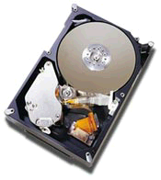
Example: Barracuda 180
181.6 GB, 3.5 inch disk
12 platters, 24 surfaces
24,247 cylinders
7,200 RPM;
7.4/8.2 ms avg. seek (r/w)
64 MB/s (internal)
0.1 ms controller time
10.3 watts (idle)
Track
Sector
Cylinder
Track Buffer
Arm
Platter
Head
Latency =
Queuing Time +
Controller time +
Seek Time + Rotation Time +
Size / Bandwidth
{
per access
Q:Calculate time to read 64 KB (128 sectors) for Barracuda 180, sector is on outer track.
+
per byte
source: www.seagate.com
Notes:
47 to 26 MB/s (external)

Slide 12
Disk Performance Example
Calculate time to read 64 KB (128 sectors) for Barracuda 180 X using advertised performance;
Disk latency = average seek time + average rotational delay + transfer time + controller overhead
= 7.4 ms + 0.5 * 1/(7200 RPM) + 64 KB / (64 MB/s) + 0.1 ms
= 7.4 ms + 0.5 /(7200 RPM/(60000ms/M)) + 64 KB / (64 KB/ms) + 0.1 ms
= 7.4 + 4.2 + 1.0 + 0.1 ms = 12.7 ms

Slide 13
Solid state device (SSD)
A data storage device that uses solid-state memory to store persistent data, typically using non-volatile flash memory.
The largest growing part of storage market since 2011.
Advantages:
Faster startup: no spin-up
Fast random access for read, low raw latency
Quiet: no moving parts
Power efficient (compared to HDDs)
High mechanical reliability: endure shock, vibration
Balanced performance across entire drive

Slide 14
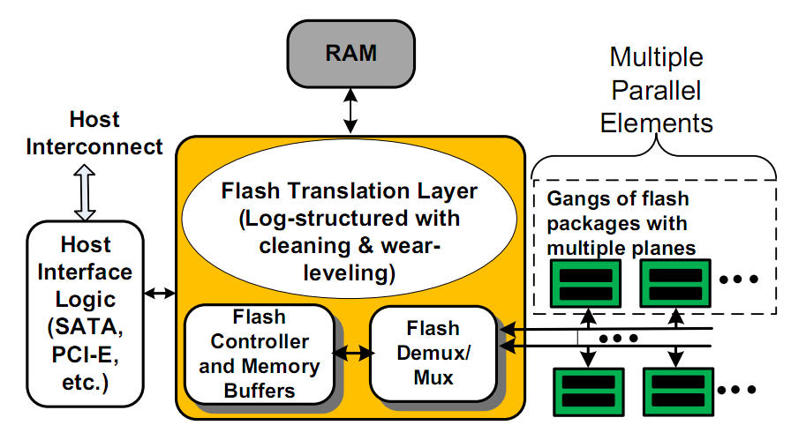
Background: SSD Architecture
Source: A. Rajimwale et al. USENIX ATC, 2009

Slide 15
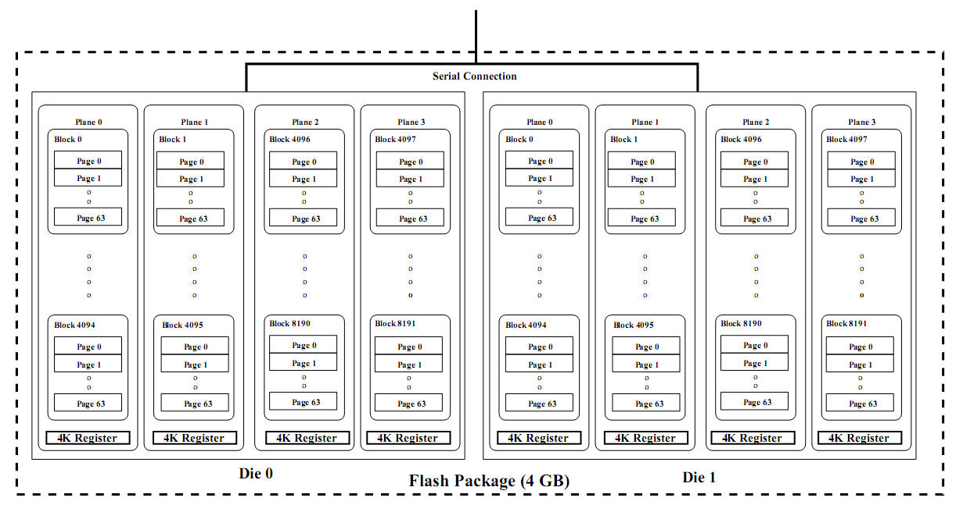
Background: Flash Memory
Read a page: 25us, write a page: 200us, erase a block: 1.5-2ms,
transfer a page via bus: 40us. Out-of-place update→garbage collection,
limited P/E cycles

Slide 16
Solid State Disks (SSDs)
I/O bus
Requests to read and
write logical disk blocks
Solid State Disk (SSD)
Flash
translation layer
Flash memory
Block 0
Block B-1
…
…
…
Page 0
Page 1
Page P-1
Page 0
Page 1
Page P-1
Pages: 512KB to 4KB, Blocks: 32 to 128 pages
Data read/written in units of pages.
Page can be written only after its block has been erased
A block wears out after some repeated write/programming times (P/E cycles).

Slide 17
SSD Tradeoffs vs Rotating Disks
Advantages
Faster startup: no spin-up
Fast random access for read
Extremely low read/write latency: much smaller seek time
Quiet: no moving
High mechanical reliability: endure shock, vibration
Balanced performance across entire storage device
Disadvantages
Price: unit price of SSD is 5-10x of HDD
Limited write cycles (Flash SSD): SLC,MLC, TLC
Slower write speed (Flash SSD): erase blocks
Vulnerable to some effects: abrupt power loss (RAM SSD), magnetic fields and electric/static charges

Slide 18
Improving disk performance
Use large sectors to improve bandwidth
Use track caches and read ahead;
Read entire track into on-controller cache
Exploit locality (improves both latency and BW)
Design file systems to maximize locality
Allocate files sequentially on disks (exploit track cache)
Locate similar files in same cylinder (reduce seeks)
Locate simlar files in near-by cylinders (reduce seek distance)
Pack bits closer together to improve transfer rate and density.
Use a collection of small disks to form a large, high performance one--->disk array
Stripping data across multiple disks to allow parallel I/O, thus improving performance.

Slide 19
Use Arrays of Small Disks?
Katz and Patterson asked in 1987:
Can smaller disks be used to close gap in performance between disks and CPUs?
Conventional: 4 disk designs
3.5”
5.25”
10”
14”
Low End
High End
Disk Array: 1 disk design
3.5”

Slide 20
Replace Small Number of Large Disks with Large Number of Small Disks! (1988 Disks)
IBM 3390K
20 GBytes
97 cu. ft.
3 KW
15 MB/s
600 I/Os/s
250 KHrs
$250K
IBM 3.5" 0061
320 MBytes
0.1 cu. ft.
11 W
1.5 MB/s
55 I/Os/s
50 KHrs
$2K
x70
23 GBytes
11 cu. ft.
1 KW
110 MB/s
3900 IOs/s
??? Hrs
$150K
Capacity
Volume
Power
Data Rate
I/O Rate
MTTF
Cost
9X
3X
8X
6X
Disk Arrays have potential for large data and I/O rates, high MB per cu. ft., high MB per KW, but what about reliability?

Slide 21
Array Reliability
MTTF: Mean Time To Failure: average time that a non - repairable component will operate before experiencing failure.
Reliability of N disks = Reliability of 1 Disk ÷N
50,000 Hours ÷ 70 disks = 700 hours
Disk system MTTF: Drops from 6 years to 1 month!
Arrays without redundancy too unreliable to be useful!
Solution: redundancy.

Slide 22
Redundant Arrays of (Inexpensive) Disks
Replicate data over several disks so that no data will be lost if one disk fails.
Redundancy yields high data availability
Availability: service still provided to user, even if some components failed
Disks will still fail
Contents reconstructed from data redundantly stored in the array
⇒ Capacity penalty to store redundant info
⇒ Bandwidth penalty to update redundant info

Slide 23
RAID 0: Nonredundant (JBOD)
file data
block 0
block 1
block 2
block 3
Disk 0
Disk 1
Disk 2
Disk 3
High I/O performance.
Data is not saved redundantly.
Single copy of data is striped across multiple disks.
Low cost.
Lack of redundancy.
Least reliable: single disk failure leads to data loss.

Slide 24
Redundant Arrays of Inexpensive Disks RAID 1: Disk Mirroring/Shadowing
recovery
group
• Each disk is fully duplicated onto its “mirror”
Very high availability can be achieved
• Bandwidth sacrifice on write:
Logical write = two physical writes
• Reads may be optimized, minimize the queue and disk search time
• Most expensive solution: 100% capacity overhead
Targeted for high I/O rate , high availability environments

Slide 25
RAID 4: Block Interleaved Parity
block 0
block 1
block 2
block 3
P(0-3)
block 4
block 5
block 6
block 7
P(4-7)
block 8
block 9
block 10
block 11
P(8-11)
block 12
block 13
block 14
block 15
P(12-15)
Blocks: striping units
Allow for parallel access by multiple I/O requests, high I/O rates
Doing multiple small reads is now faster than before. (allows small read requests to be restricted to a single disk).
Large writes(full stripe), update the parity:
P’ = d0’ + d1’ + d2’ + d3’;
Small writes(eg. write on d0), update the parity:
P = d0 + d1 + d2 + d3
P’ = d0’ + d1 + d2 + d3 = P + d0’ + d0;
However, writes are still very slow since the parity
disk is the bottleneck.

Slide 26
Redundant Arrays of Inexpensive Disks RAID 5: High I/O Rate Interleaved Parity
D0
D1
D2
D3
P
Increasing
Logical
Disk
Addresses
Independent writes
possible because of
interleaved parity
D4
D5
D6
P
D7
D8
D9
P
D10
D11
D12
P
D13
D14
D15
Example: write to D0, D5 uses disks 0, 1, 3, 4
P
D16
D17
D18
D19
D20
D21
D22
D23
P
.
.
.
.
.
.
.
.
.
.
.
.
.
.
.
Disk Columns

Slide 27
Comparison of RAID Levels (N disks, each with capacity of C)
RAID level | Technique | Capacity | Advantage | Disadvantage
0 | Striping | NxC | Maximum data transfer rate and sizes | No redundancy
1 | Mirroring | (N/2)xC | High performance, fastest write | cost
3 | Bit(byte)-level parity | (N-1)xC | Easy to implement, high error recoverability | Low performance
4 | Block-level parity | (N-1)xC | High redundancy and better performance | Write-related bottleneck
5 | Interleave parity | (N-1)xC | High performance, reliability | Small write problem

Slide 28
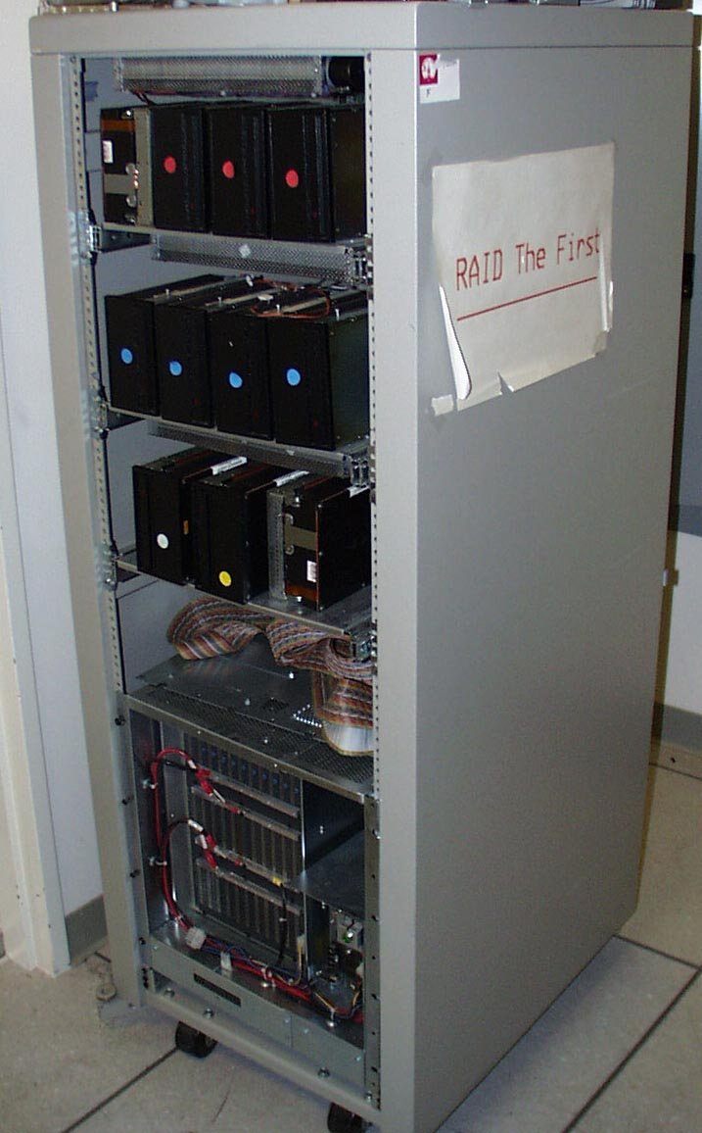
Berkeley History: RAID-I
RAID-I (1989)
Consisted of a Sun 4/280 workstation with 128 MB of DRAM, four dual-string SCSI controllers, 28 5.25-inch SCSI disks and specialized disk striping software
Today RAID is hundreds of billion dollar industry, 80% non-PC disks sold in RAIDs

Slide 29
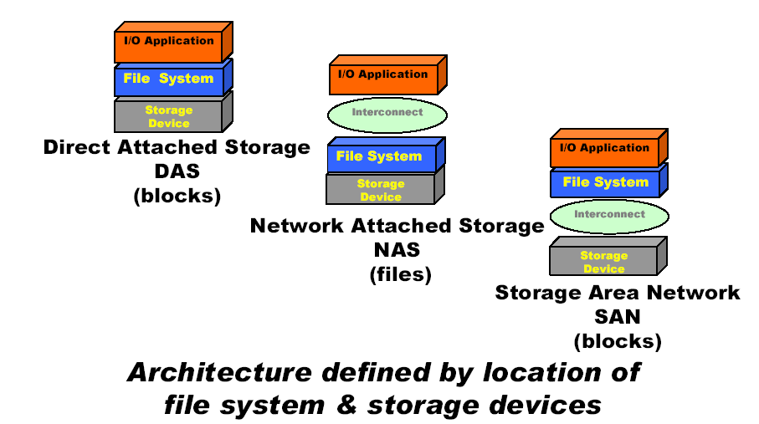
Storage Architectures

Slide 30
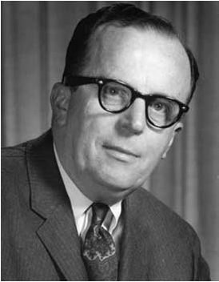
What is cloud storage?
History
J.C.R. Licklider – One of the fathers of the cloud computing idea.
Global network that allows access from anywhere at anytime.
Concept
Cloud storage is a service model in which data is maintained, managed and backed up remotely and made available to users over a network (typically the Internet).

Slide 31
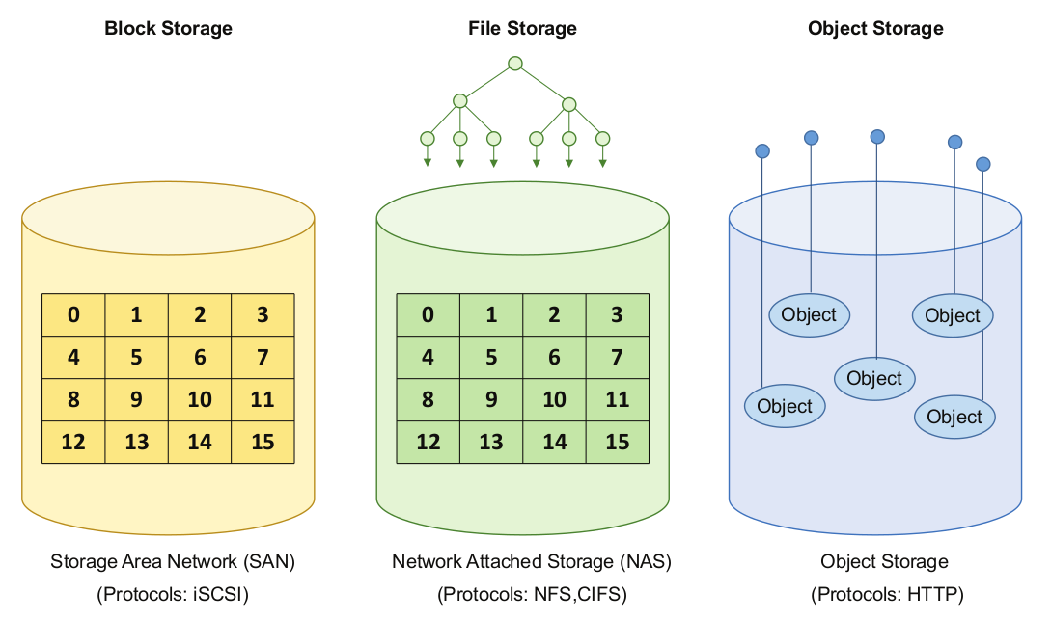
Storage Types
In cloud computing environments, three types of storage solutions are offered:
Block storage
File storage
Object storage
Notes:
AWS:
S3: object,
EBS: block
EFS: file

Slide 32
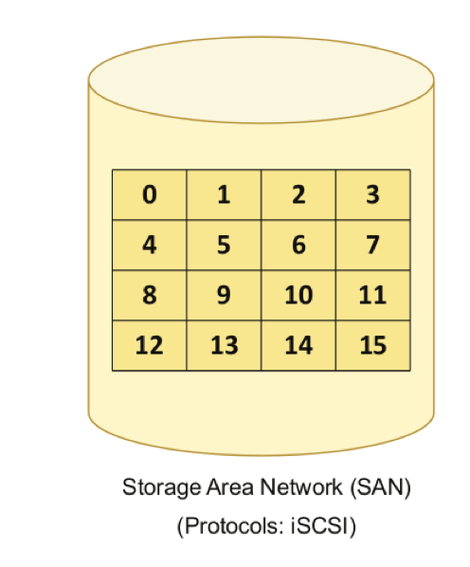
Block Storage
Block storage operates at the operating system kernel level, and the data is stored and organized as an array of blocks.
In Block storage, the data is stored without any concept of data format or type.
Block storage is accessed over the network as a Storage Area Network (SAN) using protocols such as iSCSI.
Notes:
AWS EBS

Slide 33
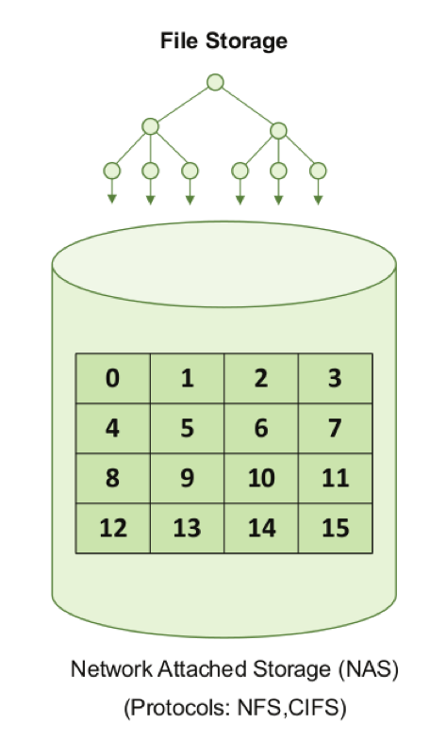
File Storage
File storage operates at the operating system user level, and the data is stored as data blocks which are managed by a file system.
In file storage, data is managed as a named hierarchy of files and folders.
Files have meta-data associated with them (such as file name, type, and creation date).
File storage is accessed over the network as a Network Attached Storage (NAS) using protocols such as Network File System (NFS) or Common Internet File System (CIFS), HDFS.

Slide 34
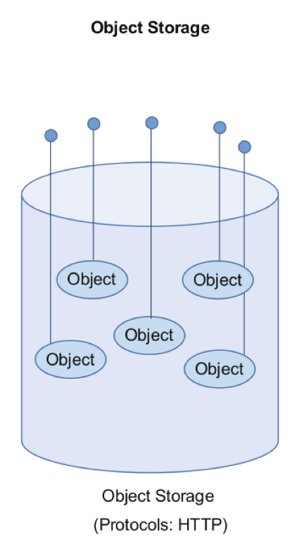
Object Storage
Object storage operates at the application level, and the data is stored as objects.
Each object consists of an object identifier (OID), data, and meta-data.
Object storage is accessed with protocols such as HTTP using REST APIs.
Notes:
AWS S3

Slide 35
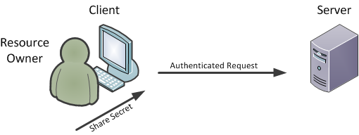
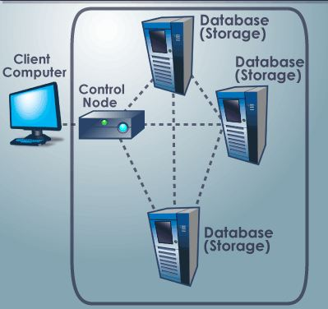
How does cloud storage work?
Redundancy
Core of cloud computing
Equipment
Data servers
Power supplies
Data files
Replication

Slide 36





Cloud storage
Laptop
Cloud Storage
H.Gunawi, Toward reliable cloud storage, UC Berkeley

Slide 37
Reliability, availability
Internet-service FS:
GoogleFS, HadoopFS, CloudStore, ...
Key-Value Store:
Cassandra, Voldemort, ...
+ Replication
+ Scale-up
+ Migration
+ ...
Reliable?
“This is not just data.
It’s my life.
And I would be sick
if I lost it”
[CNN ’10]
Structured Storage:
Yahoo! PNUTS, Google BigTable, Hbase, ...
Highly-available?
Custom Storage:
Facebook Haystack Photo Store,
Microsoft StarTrack (Map Apps),
Amazon S3, EBS, ...
H.Gunawi, Toward reliable cloud storage, UC Berkeley

Slide 38
How to improve reliability in data centers?
Redundancy
Replication: making copies
Erasure Coding

Slide 39
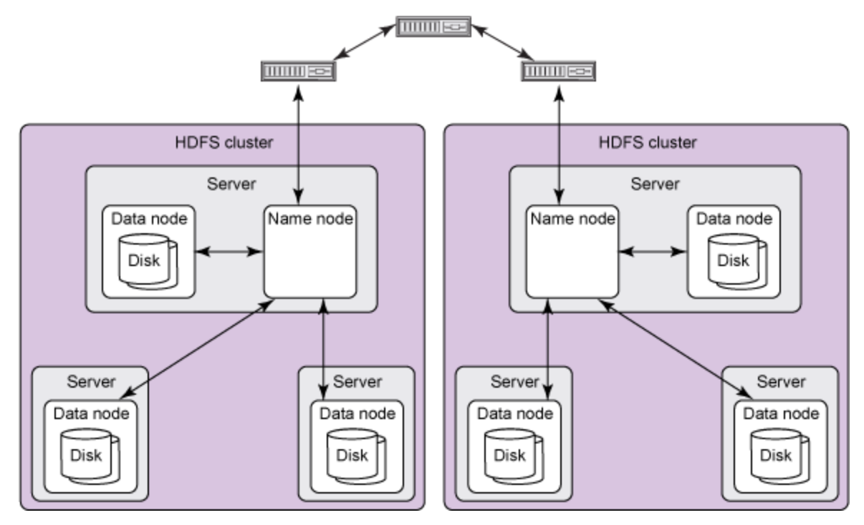
Data replication (HDFS)
HDFS replicates file blocks for fault tolerance. An application can specify the number of replicas of a file at the time it is created, which can be changed any time. The name node makes all decisions concerning block replication.
https://www.ibm.com/developerworks/library/wa-introhdfs/index.html

Slide 40
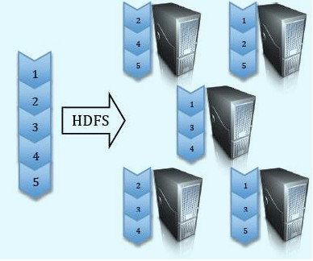
HDFS block replication (Default: 3 replicas for every block)

Slide 41
How to improve reliability in data centers?
Redundancy
Replication: making copies
Erasure Coding

Slide 42
Erasure Coding
(m+k, k) erasure code
Able to recover from loss of up to any m data symbols
HDFS can use erasure coding by utilizing a middleware layer called HDFS-RAID
[http://wiki.apache.org/hadoop/HDFS-RAID]
Notes:
Decades old concept of erasure coding
Has been used from satellite communication to signal processing to recently data storage in large clusters or RAID systems
It creates M redundant data symbols from K data symbols
When some data symbols are lost due to hardware failure or data corruption, we can recover the lost symbols by performing decoding operation on remaining symbols. The max number of symbol loss we can recover from is m.
Huge reduction in storage overhead.

Slide 43

FINGER: A Novel Erasure Coding Scheme Using Fine Granularity Blocks to Improve Hadoop Write and Update Performance
Pradeep Subedi, Ping Huang, Benjamin Young, Xubin He
Electrical and Computer Engineering
Virginia Commonwealth University

Slide 44
Introduction
Scaling of storage systems, i.e., thousands of computation/data/storage nodes
BUT higher probability of node failures
HDFS, Google File System, Microsoft Azure provide fault tolerance
Replication of data
Erasure Coding
Replication
Requires 3 copies of data for two node fault tolerance
Very high storage cost (200% storage overhead)
Notes:
HDFS cluster includes thousands of nodes.
Larger components, means at any point of time some of the nodes are not available i.e. Higher probability of failure
For tolerance from the failures, many service providers employ either replication or erasure coding or both.
HDFS has both replication and erasure coding.
Replication is ....

Slide 45
Typical Hadoop Cluster
Any data in HDFS divided into fixed size blocks
Namenode keeps track of all blocks
Blocks distributed across Datanodes and Racks for fault tolerance
Rack-aware block placement policy for replicas
Preserve network bandwidth
Source: hadoop.apache.org
Notes:
The first replica is placed on the local node or random node on the same rack as the client, while the second and third replicas are placed on a different rack.
The reason for placing two replicas in the same rack is to preserve network bandwidth; the assumption in HDFS is that the in-rack network has higher bandwidth and lower latency than the inter-rack network

Slide 46
Motivation
HDFS essentially keeps the data immutable, only allowing concurrent appends.
Many user applications are write intensive and require file modifications.
1% of true HDFS writes translates to 64% of the final disk load as write I/O for HBASE applications.
Write amplification due to logging, compaction, and replication
Allowing updates to HDFS blocks reduces the logging and compaction overhead
Storage overhead of Replication is reduced by erasure-coding
BUT erasure coding introduces additional I/O and computation overhead during updates or file changes
[T. Harter et. al. FAST’14]
Notes:
Mapreduce deals with write-once read many applications, while Hbase deals with write and update heavy applications
HDFS keeps data immutable. This introduces extra operations, the upper-layer system needs to perform for providing true-fs capabilities.

Slide 47
Motivating Example
Replication
File Level
Erasure Coding
Directory Level
Erasure Coding
Notes:
When file 1 or any other blocks changes, requires re-calculation of block 9 and 10, which requires reads of block 2,3 and 4 and writes for 9 and 10.
More reads and writes
One potential solution to eliminate the block reads is reduce the block size so that File 1 has 4 blocks, so no need to read data from other files. But increase in Metadata and limits the numbers of files supported by Hadoop.
While larger block size allows us to keep small metadata footprint, it introduces overhead during file content changes.

Slide 48
Our Fine Granularity Erasure Coding Scheme
Propose A new block-layout policy in erasure coded HDFS called FINGER
Erasure-coding efficient block layout
Allows block level updates
Use of multi-threaded online encoding and decoding
Contrast to single threaded and offline erasure coding in HDFS-RAID
Notes:
For file content modifications, we allows block level updates. So that changing a small block in large file eliminates the need to read and write all of the large file instead of the updated block only.
We deal with erasure coded Hadoop in our work.
Perform online erasure coding.
First replication and in background erasure coding introduces high network cost i.e. twice the amount of work than online erasure coding.

Slide 49
FINGER Design Goals
Reduce the effective block size of erasure coded HDFS, while keeping the same metadata size
Small blocks ≈ More erasure-code stripes
Less data to read/write during parity re-computation
Perform erasure coding inside each block only
Contrast to erasure coding across blocks
Changing individual block does not require reads and writes to other data and parity blocks

Slide 50
FINGER Architecture
Separate threads encode/decode individual blocks
Block Chunking
Erasure Coding
Stored as a single block
Allows content updates/modification from block boundaries
Notes:
Introduce a finger client
The client data consists of 4 blocks
Block A is divided into 4 chunks, then erasure coding is performed
Then distributed to multiple nodes. Now when we get Block B, we chunk, erasure code and append it to the original block. Same is done for other blocks.
Since, we store the small chunks as appended blocks, we don’t need extra metadata information.
For writes, since we do perform erasure coding, we eliminate the need to triplicate the data by performing multi-threaded online erasure coding. Thus reduces the amount of data we need to write
For updates to the blocks, we limit the in-place update to be the size of the block. So, we can just overwrite the data blocks or write the new data to another place and invalidate the old data.
This eliminates the need to read the old data and replace it by re-computing the parity. Because previously, to re-compute the parity, we needed to read all other data blocks in the stripe to update the parity. Now we just compute the parity and invalidate the old parity chunk and replace with new parity chunk.

Slide 51

Reads in FINGER
Read request is sent to FINGER client
Chunk offsets are determined from original read-request offset & block size
Normal Reads
Degraded Reads
Erasure Code Decoding
Notes:
We read request is redirected to the finger client.
It determines the chunk offsets from the original offset and the block size
Then issues reads to the underlying blocks, then it is issued to the client after block is constructed in client
If failure happens, and we want to read block D, decoding is performed and read is issued.
The advantage is the data requested by client can be used to decode the failed data, i.e, we don’t need to read extra data for performing recovery during failures

Slide 52
FINGER Performance Evaluation
Implementation in FINGER in HDFS ver. 0.22.0
Deployed the HDFS cluster running 10 Datanodes and 1 Namenode
All nodes are Linux-based machines with two 2.30Ghz Intel Xeon CPU E52630 processor, 64GB RAM and 320GB hard drives
Nodes are equipped with Ethernet Interface card of 1Gbps speed and interconnected by 24-port HP 1810-24G switch
Use of Reed-Solomon Code {RS(6,4) and RS(10,8)} as Erasure Code
Evaluated the Write-Throughput, Disk I/O, Update Throughput, Meta-data Size, Read and Recovery throughput

Slide 53
FINGER Update Performance
Notes:
Updating individual blocks, we can see how traditional erasure coding suffers. Think of the motivating example before. How much degradation is there if we want to change File 1 contents.
Larger blocksize negatively impacts the update performance and also larger stripe size.
Finger keeps the update throughput same as small block sized HDFS, while maintaining the metadata size as that of large block size.

Slide 54
FINGER Disk I/O for File Update
Notes:
Illustrates the amount of data needed to read and write during the block updated operations.

Slide 55
FINGER Write Performance
Notes:
32% increase w.r.t. replication
5% with HDFS-RAID
For write performance, block size variation does not have significant impact.

Slide 56
FINGER Disk I/O for File Write
Notes:
Amount of data transmitted over network and written into the disk
(10,8) has less amount of data to write than (6,4) for parity
Erasure coding reduces amount of data written, thus we have better performance.

Slide 57
FINGER Read Performance
Notes:
We keep similar read performance. This is when there are no failures. The performance is similar because systematic erasure coding only computes parity and keeps the original data same. No need to perform decoding, when there are no node failures.

Slide 58
FINGER Recovery Performance
Notes:
This shows the impact of erasure coding. The decrease in recovery performance of HDFS-RAID is due to the need to perform erasure decoding. We need to read other blocks, perform decoding and then supply the content to the client. While replication just switches to new block location.
FINGER has better performance than HDFS RAID due to multi-threaded decoding. Keep in mind that we can perform multi-threaded decoding because individual chunks can be recovered independently, while HDFS-RAID has dependent blocks, thus is unable to perform multi-threaded decoding.

Slide 59
Conclusion
A new block-layout mechanism for erasure-coded HDFS
Default HDFS favors large block size, while Erasure coding favors small block size
Implement block-chunking and multi-threaded erasure coding scheme
FINGER keeps same metadata size as HDFS-RAID
Increase in update performance
Due to reduction in amount of data read and written to data nodes
Gain in update throughput by up to 5.68 times w.r.t. HDFS-RAID and 8.6% w.r.t. 3-way replication
Improved write performance
Increase in write throughput by up to 32% w.r.t. 3-way replication and 5.02% w.r.t. HDFS-RAID
Maintain similar read and improve recovery rate by 6.9% w.r.t. HDFS-RAID

Slide 60
Next
November 27: No class, Happy Thanksgiving!
December 4: Lectures from two industry experts (via Zoom)
December 11: 5:30-7:30 pm, final exam

